Slide 1

SUPPER PROGRAM FOR FOOD SERVICES STAFF
Notes:
PLACEHOLDER

Slide 2
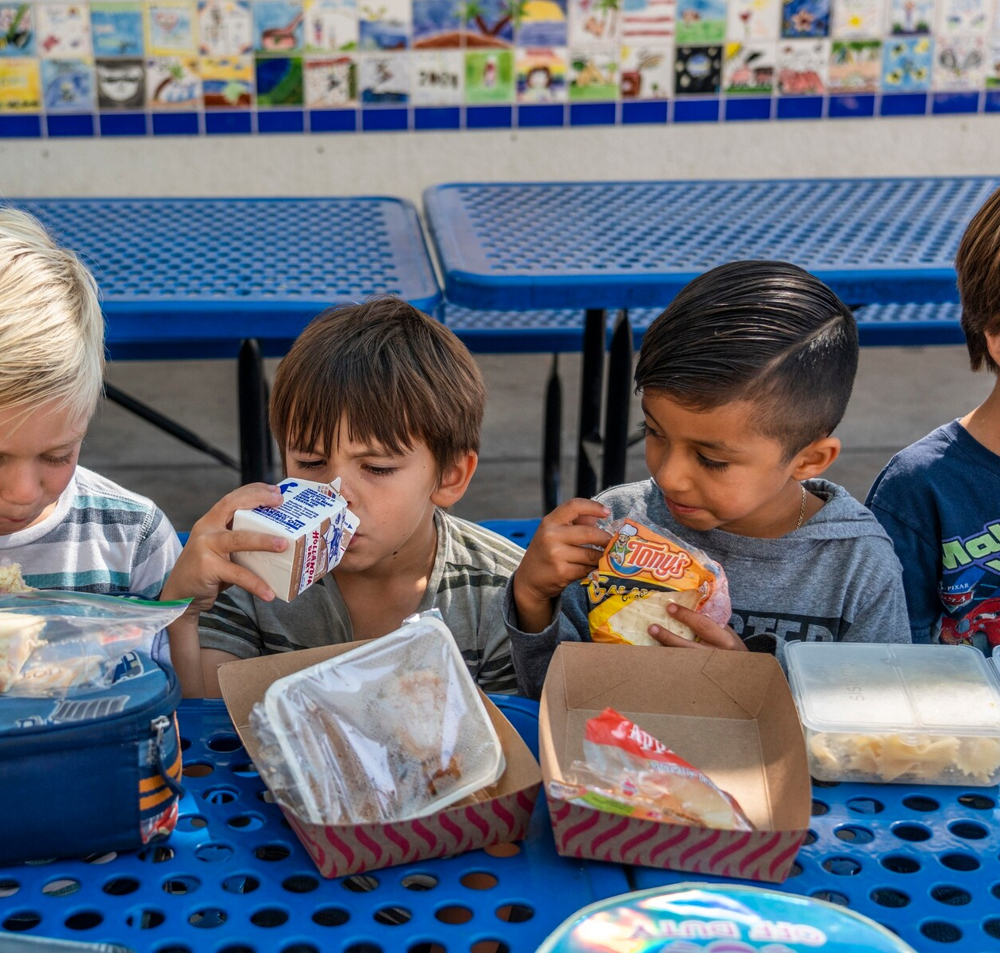
Objective
The goal of the Food Services Division is to provide access to nutritious supper meals to as many students and community participants of eligible schools with afterschool programs.
Notes:
TELL: The goal of the Food Services Division is to provide access to nutritious hot supper meals to as many students and community participants of eligible schools with afterschool programs.

Slide 3
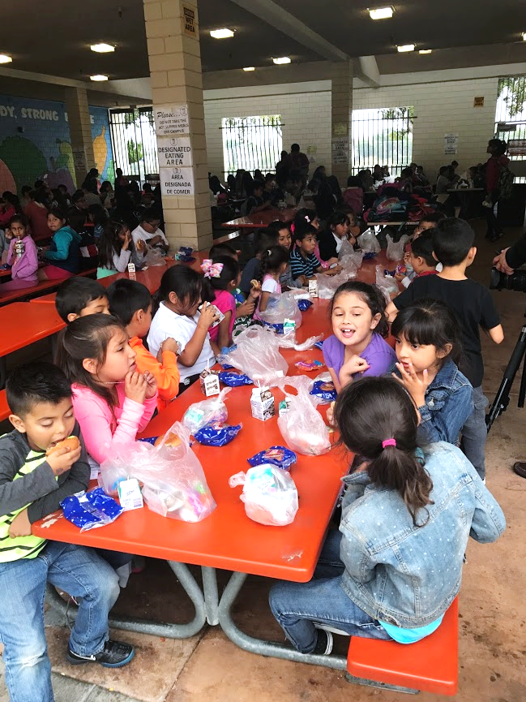
Supper Program Eligibility
There must be an enrichment program on site to offer the Supper Program.
  Schools must be greater than 50% eligible
  Community children under the age of 18 are eligible
  Adults over 18 with disabilities may participate
Notes:
TELL: Participants ages 18 and under are eligible for a free supper meal after school. Participants do not have to be enrolled in an after school program or participate in any offered activities. Disabled individuals of any age may participate.

Slide 4
Annual Training
FSD is required to provide annual CACFP supper training to all Food Services (FS) and After School Program (ASP) staff before the start of every school year, new program, and to new employees.
Notes:
TELL: FSD is required to provide annual CACFP supper training to all Food Services (FS) and After School Program (ASP) staff before the start of every school year, implementation of a new program, and to new employees.

Slide 5
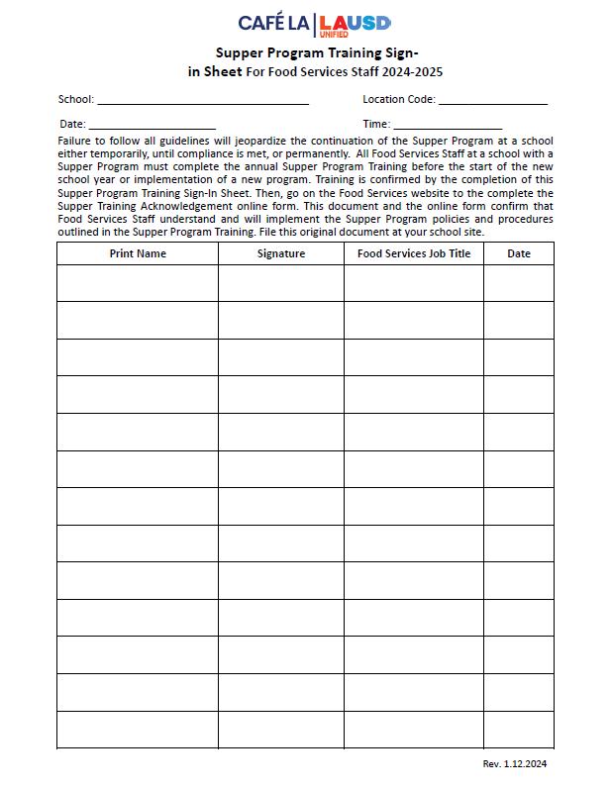
Training Verification Forms
  FS Supper Program Training Sign in sheet
There are two Supper Program Training Sign-In Sheets:
Once FS staff has been trained and the sign-in sheet has been signed an online training acknowledgement form must be completed.
Notes:
TELL: Let’s talk about the Counting and Claiming forms. There are 2 versions of the ASP Supper Grid Sheet and the Community Roster: a 5-day and 1-day. Let’s begin with the ASP Supper Grid Sheet.

Slide 6
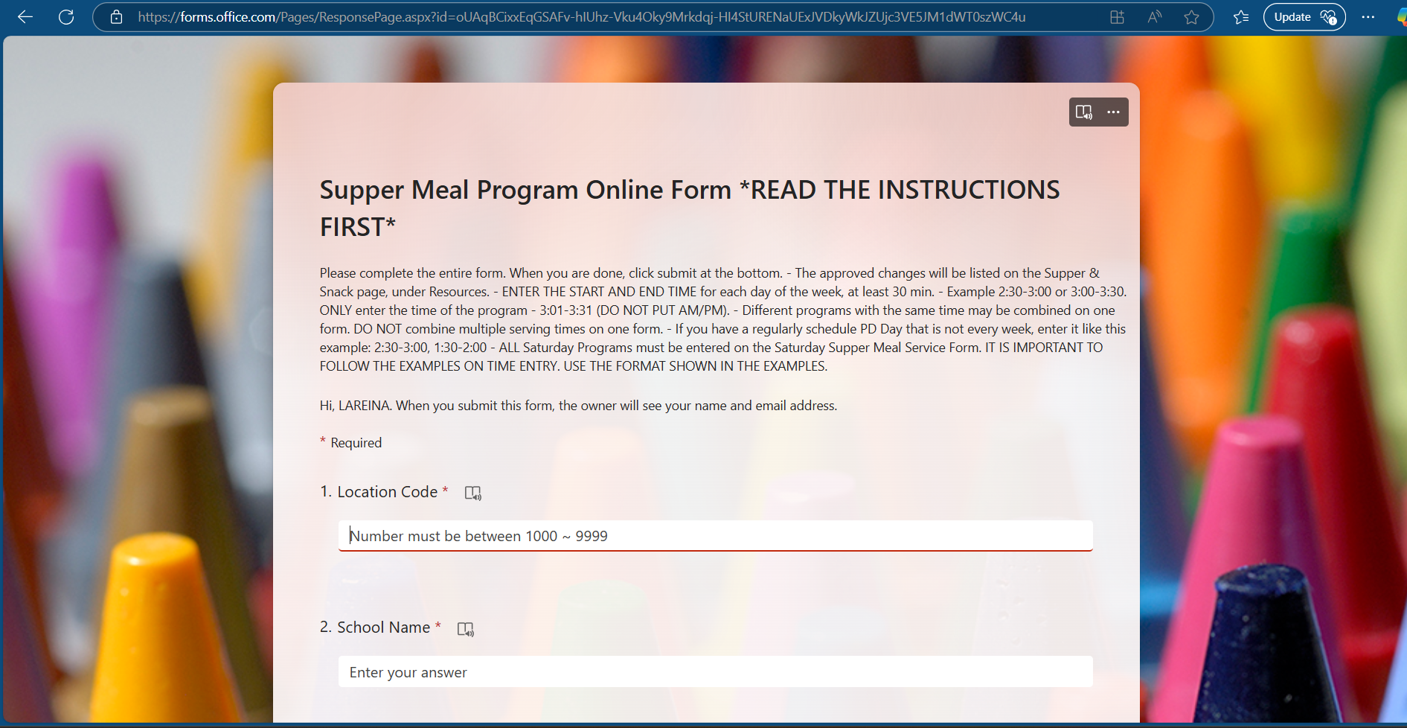
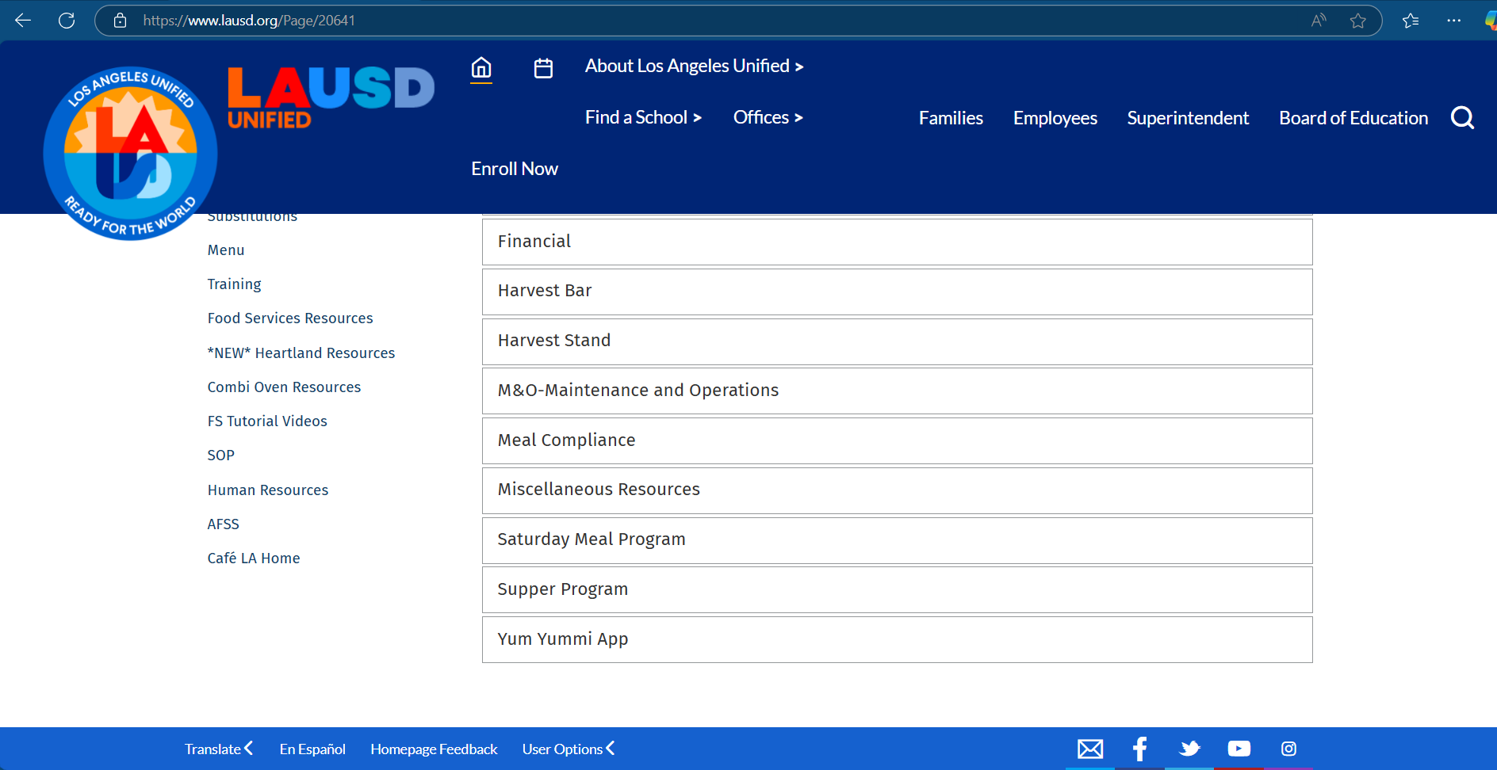
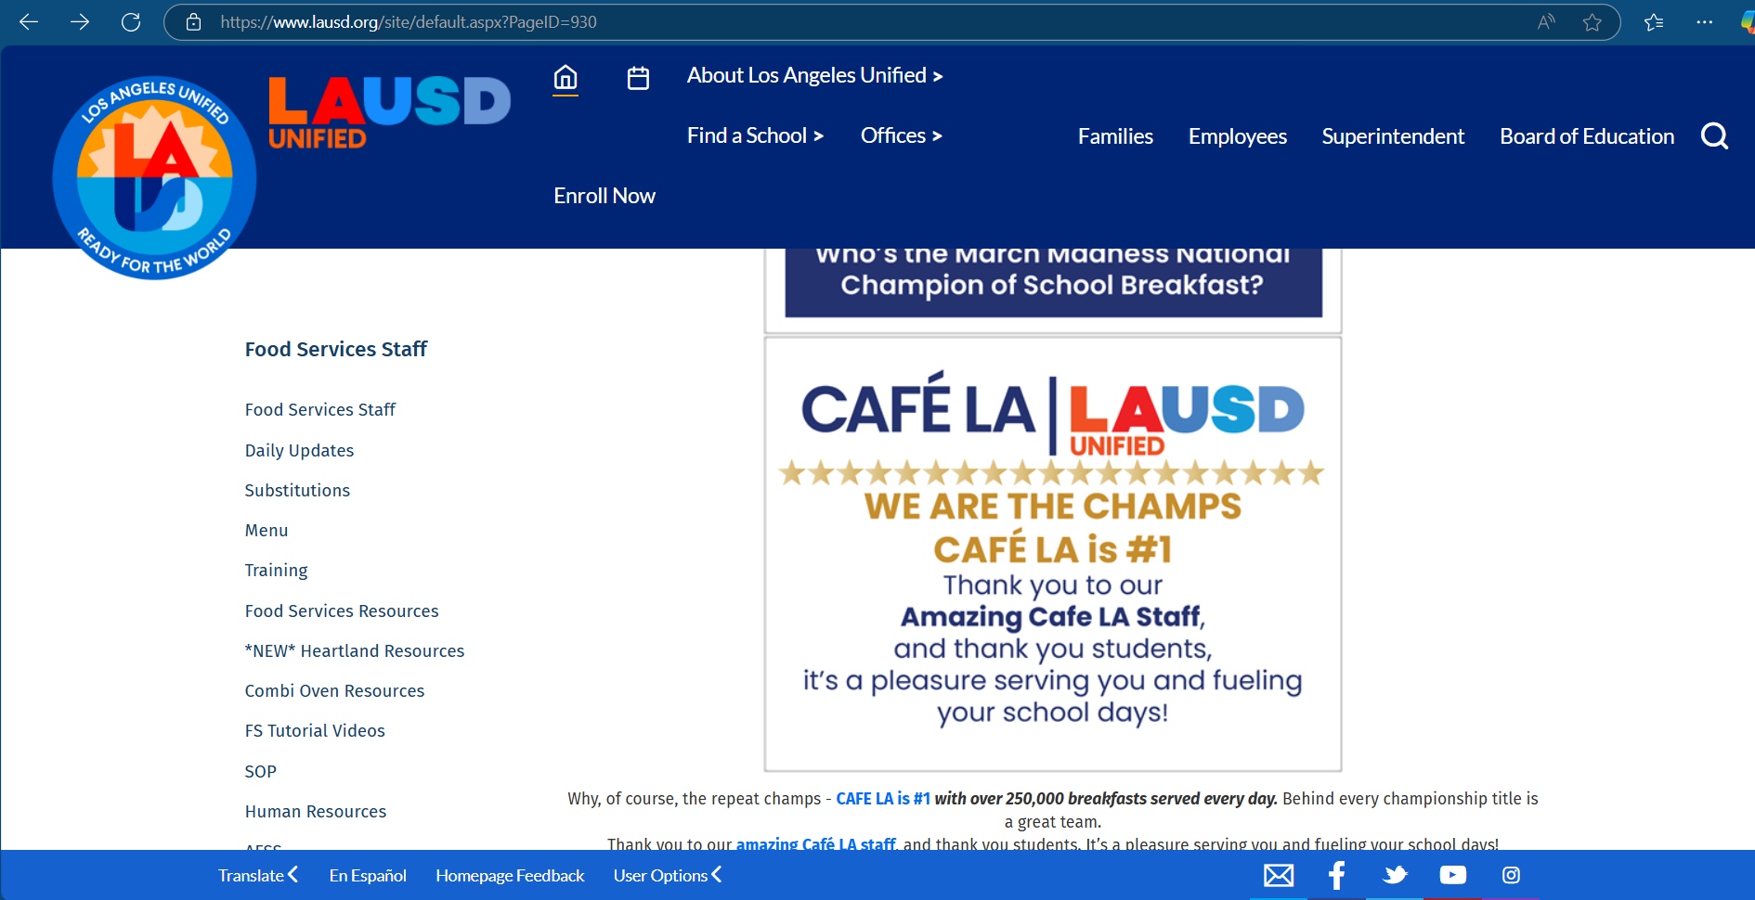
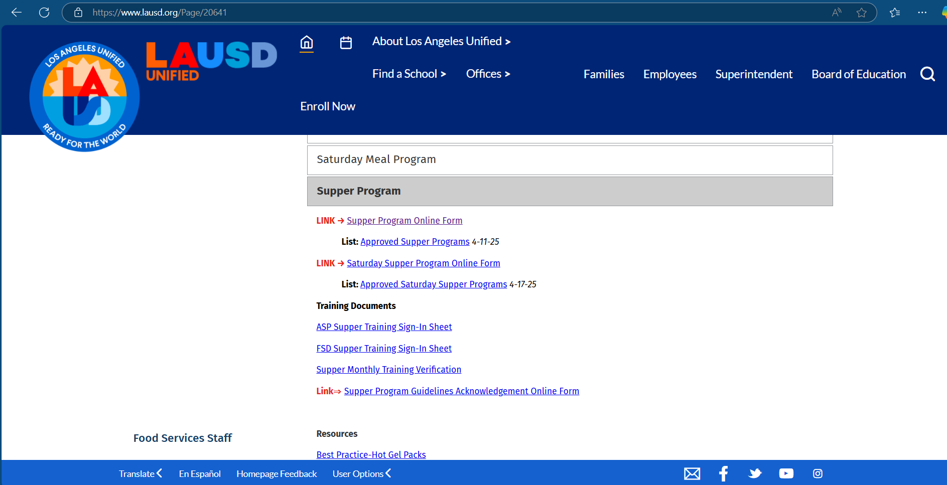

Training Acknowledgement
All trained FS Staff must complete the Supper Training Acknowledgement online form to verify completion of annual training.
  One online form per employee.
  Online form is located on the Supper page on the FS website.
Note: Due August 22, 2025

Slide 7
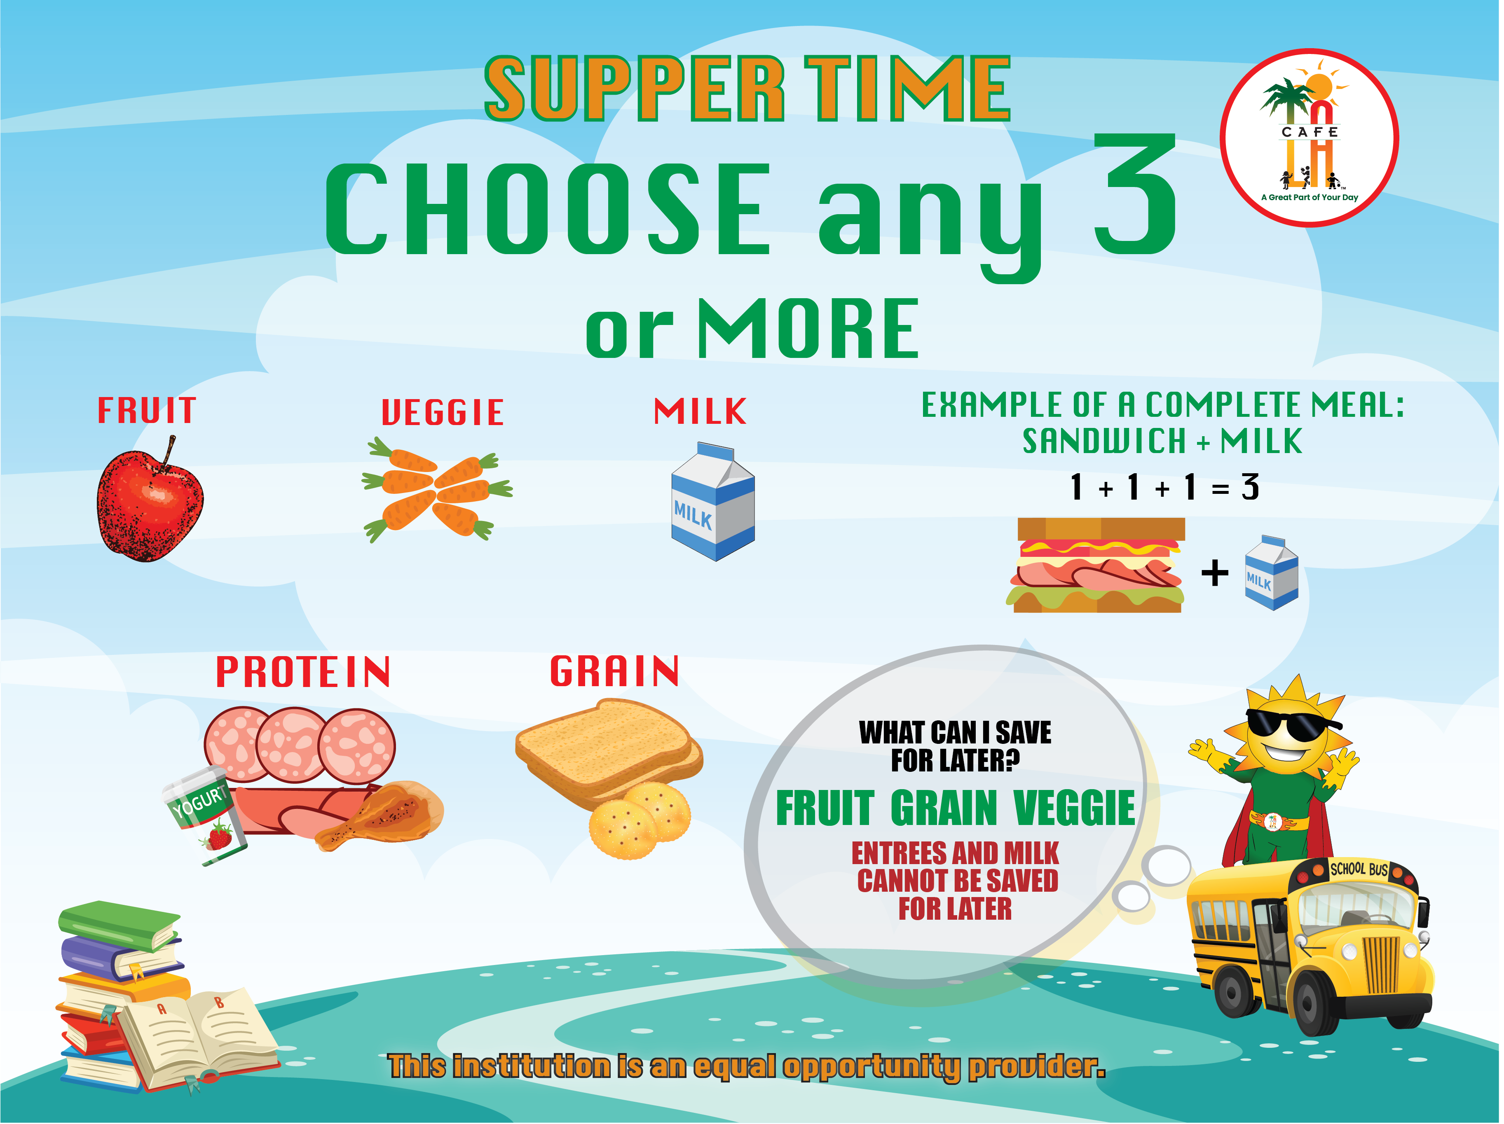
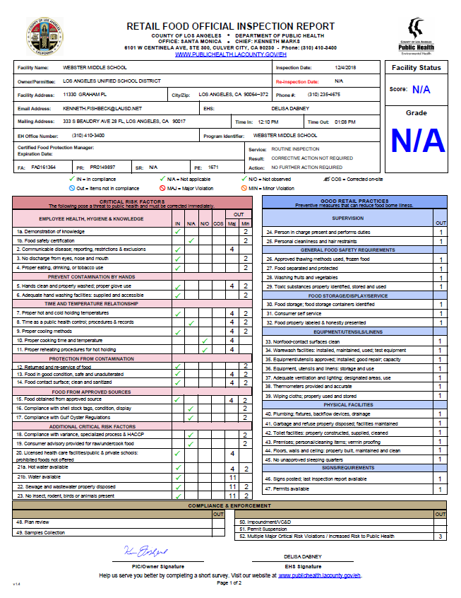
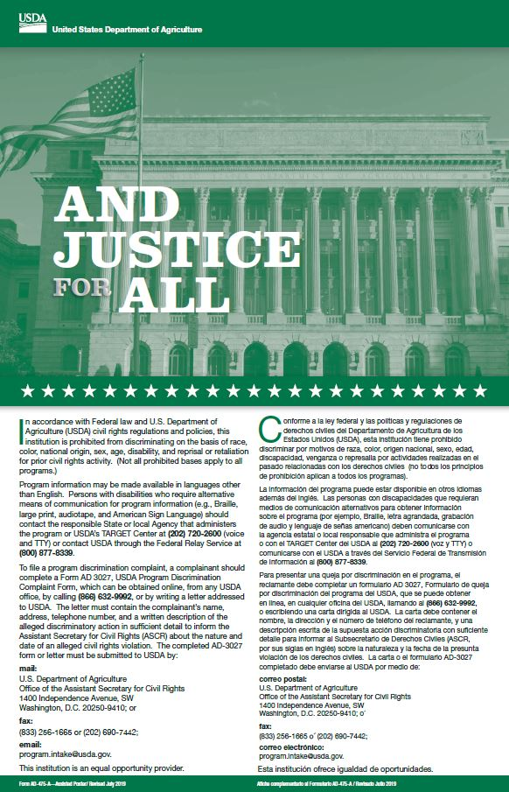
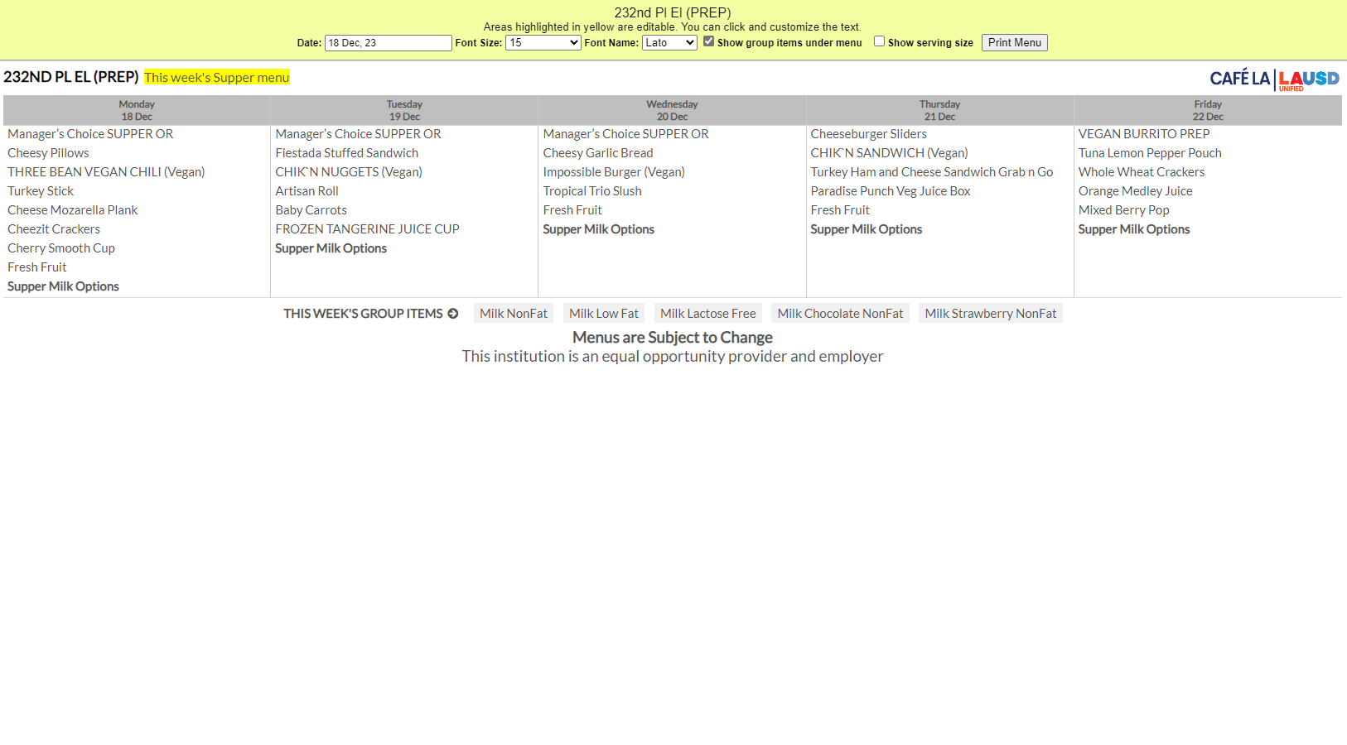
Mandatory Postings
Offer vs Serve Supper Guide
Health Inspection Report
And Justice for All
(11” x17”)
Post all 4 at every service area visible to public view.
Supper Menu
Notes:
TELL: Here are the four required postings for the Hot Supper Program. The Offer vs Serve Supper Guide, the Supper Menu, the Health Inspection Report, and the And Justice for All poster. All three must be posted at every service area visible to public view.

Slide 8
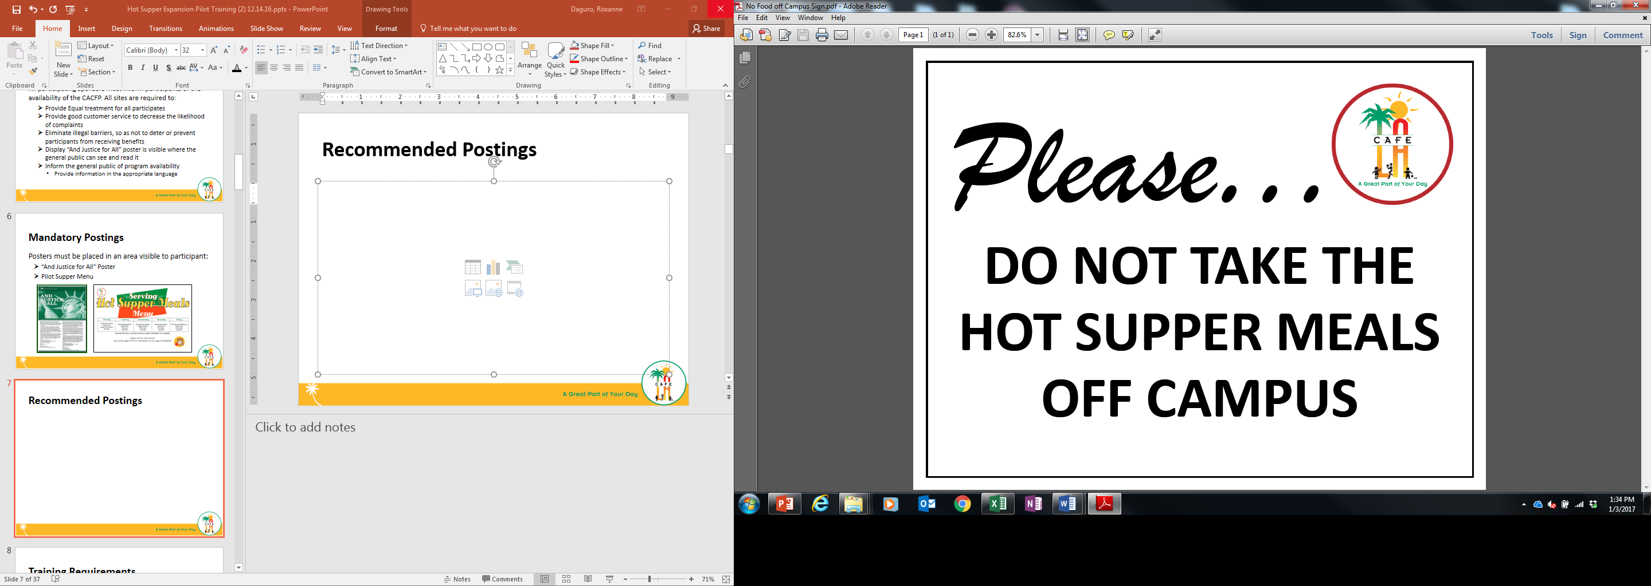

Eating Area Posters
Used to aid students in where to eat supper meals.
Notes:
TELL: Continue to post the Hot Supper marketing material for visual appeal and instruction.

Slide 9
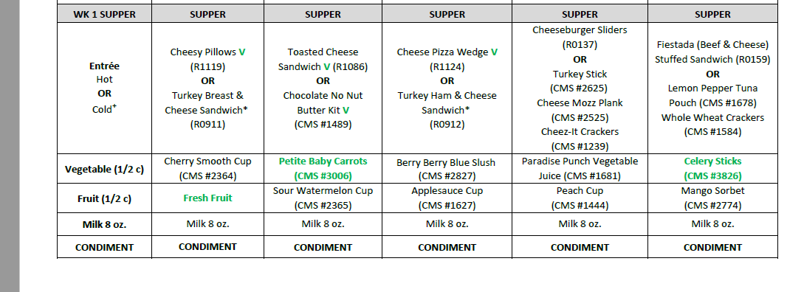
Supper Menu: Entrée
There are two entrée options to choose from for supper. Every day, choose from a hot or cold option to serve.
Do not serve both entrée options
All entrée items count towards 2 components:
  Meat/ meat alternate & grain

Slide 10
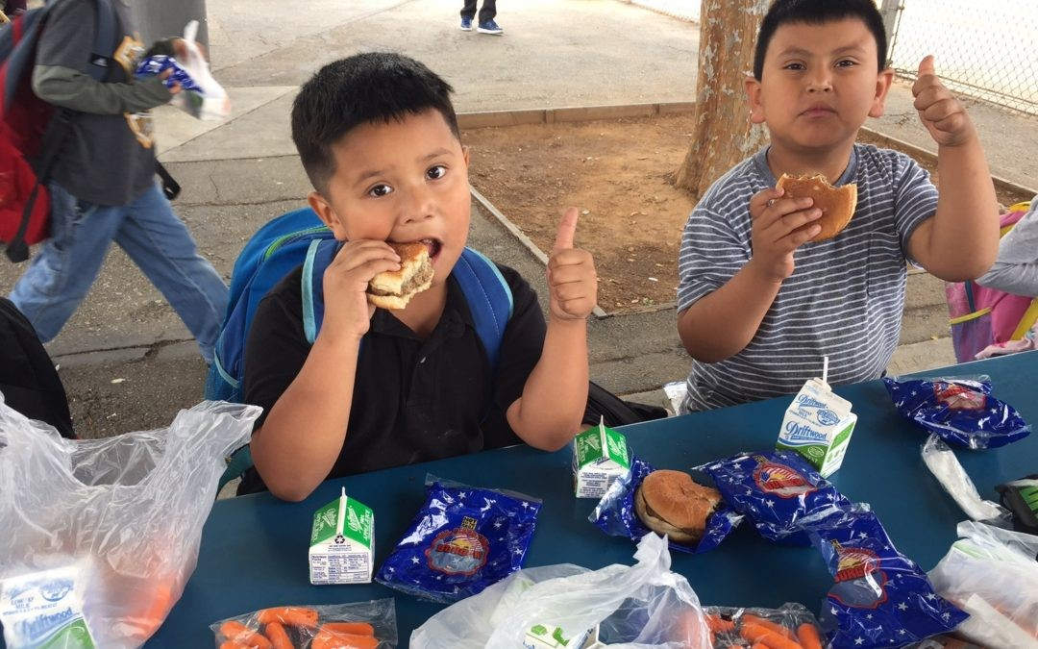
Supper Entrée Selection
When deciding between a hot and cold supper item, serve the entrée that will drive the most participation from students at your site.
Serve the more popular item from the menu
Increased participation results in greater revenue
Our service goal is customer satisfaction over convenience

Slide 11
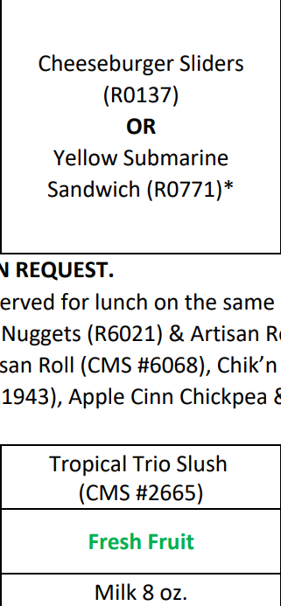
Entrée Satisfaction Activity
If a majority of students are going to want the Cheeseburger entrée, then offer it on the menu rather than the Yellow Submarine Sandwich.
Let’s put ourselves in our student’s perspective.
How many times a week would you like to receive a cold sandwich before you stopped coming to the cafeteria for supper?
If you were a student at your school, in any grade, what entrée would you select from the menu?

Slide 12
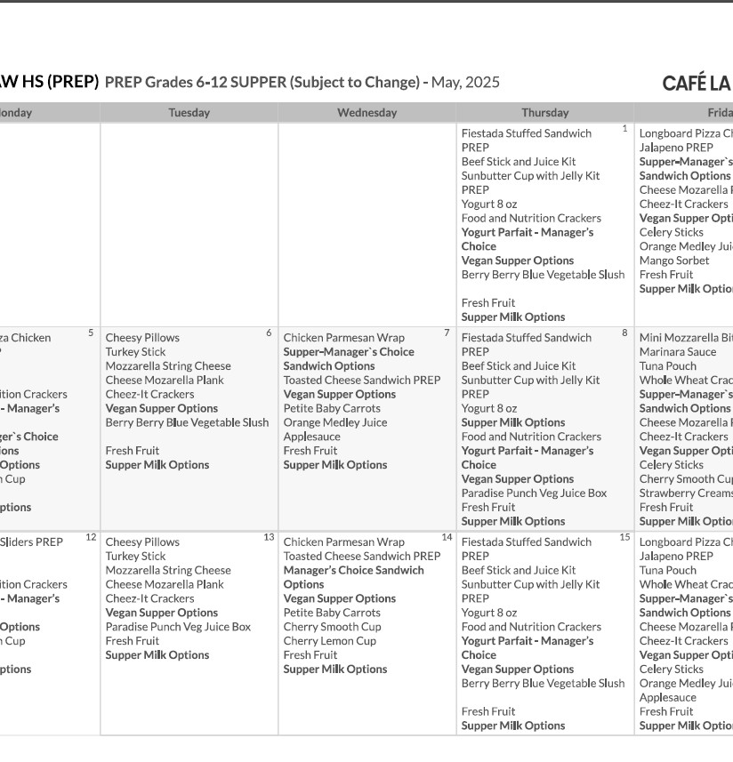
Menu Guidelines
All 5 components must be available to every participant during service; only 3 are required to be selected.
Prepare the “4 and Under” menu for AECP and community participants under the age of 4.
Offer 2 different types of milk,

Slide 13
MEAL PATTERNS & SUBSTITUTIONS
Ensure portion size and component type meet reimbursable meal requirements.
  Posted menu must indicate substitutions
  Cross out former food item and write substitution made in RED pen
Baby Carrots
Notes:
TELL: Substitutions happen, ensure portion size and component type meet reimbursable meal requirements. And remember, the posted menu must indicate substitutions.

Slide 14
Unequal Component Substitution
MEAT & GRAIN
MEAT
Breaded Chicken Tenders
Chicken Drumsticks
VS
VEGETABLE
FRUIT
Cherry Smooth Cup
Frozen Strawberry Creamsicle
Notes:
TELL: Let’s identify the components of the following menu items. What components make up the Buffalo Chicken Bites?
CLICK
TELL: That’s right, meat and grain. And the Chicken Drumstick?
CLICK
TELL: Meat. Is that an equal substitution of components? No. Let’s take a look at another example. What component is the Cherry Smooth Cup?
CLICK
TELL: That’s right, it is vegetable. Now what about the Frozen Wild Cherry Cup?
CLICK. It’s a fruit. Is that an equal substitution of components. No, it is not.

Slide 15
Chocolate Milk Rule
The CACFP guidelines restricts the serving of chocolate milk to students under 1st grade.
  Offer unflavored milk to children in grades kinder and under.
  Children in 1st grade and above can choose between unflavored or chocolate milk
Notes:
TELL: Now let’s talk about chocolate milk. The CACFP guidelines restricts the serving of chocolate milk to students under the age of six. Children under six must be offered unflavored milk. However, children six or older can choose between unflavored or chocolate milk.

Slide 16





Reimbursable Meals
Supper meal service adheres to OVS guidelines.
3 of the 5 meal components must be selected to complete a reimbursable meal.
Student is not required to take a vegetable or fruit during supper

Slide 17
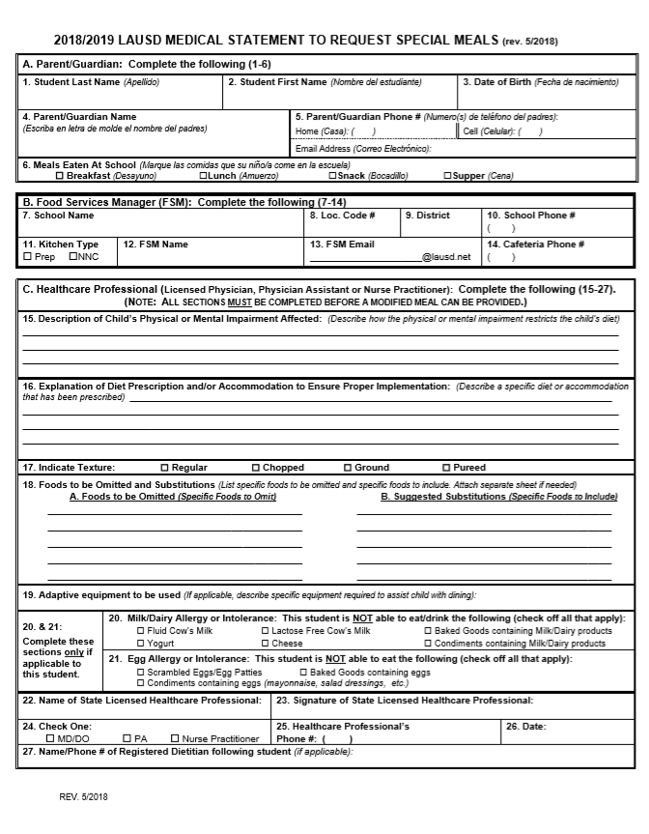
Special Dietary Needs
    Students who require a special meal can complete the “Medical Statement to Request Special Diets” form. Food Services Managers will:
    Provide the form to families for completion by the child’s treating physician
    Submit the completed form to the Nutrition Specialists
    Make substitutions provided by the Nutrition Specialist
Notes:
TELL: Ensure that temperatures recorded at the Start of Service are within the allowable serving range for safety reasons. Please note that temperatures of cold supper kits and cold food items must also be recorded on the Food Temperature Log.

Slide 18
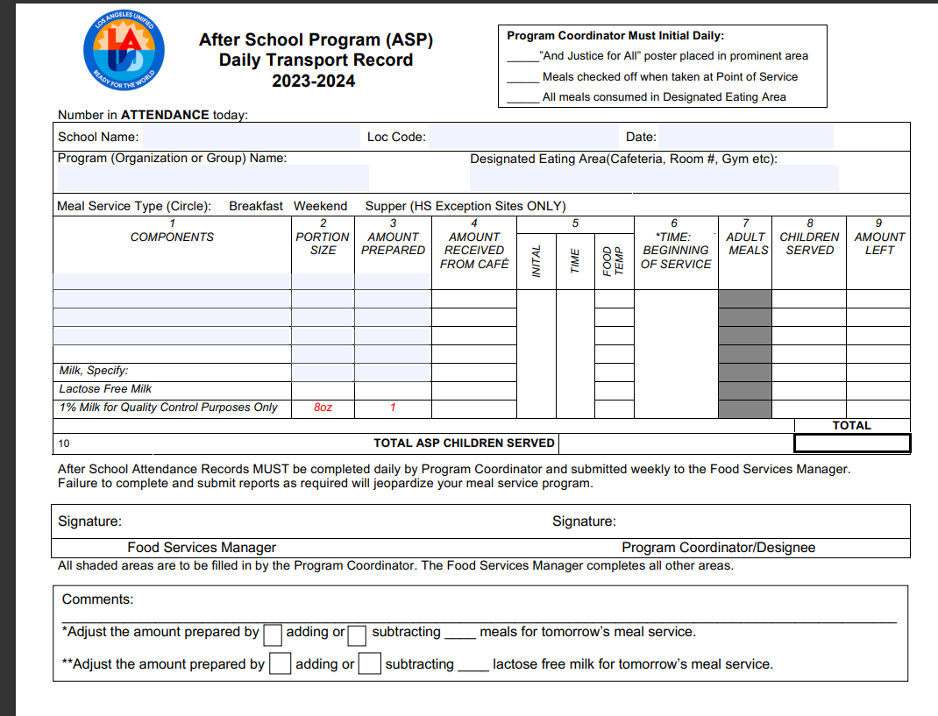
Supper Transport Record
    Supper transport record is used whenever food is being served outside of FSD hands.
    Manager or Food Service Staff will:
    Pre-fill the header with school name, location code, date, ect.
    Pre-fill components portion size and amount prepared.
Once received ASP staff will then fill amount received, temp each item and document all counts for meals served.
ASP coordinator must sign at the end of service before returning transport record.
    Manager will sign once record is returned. Signifying all fields have been properly filled.

Slide 19

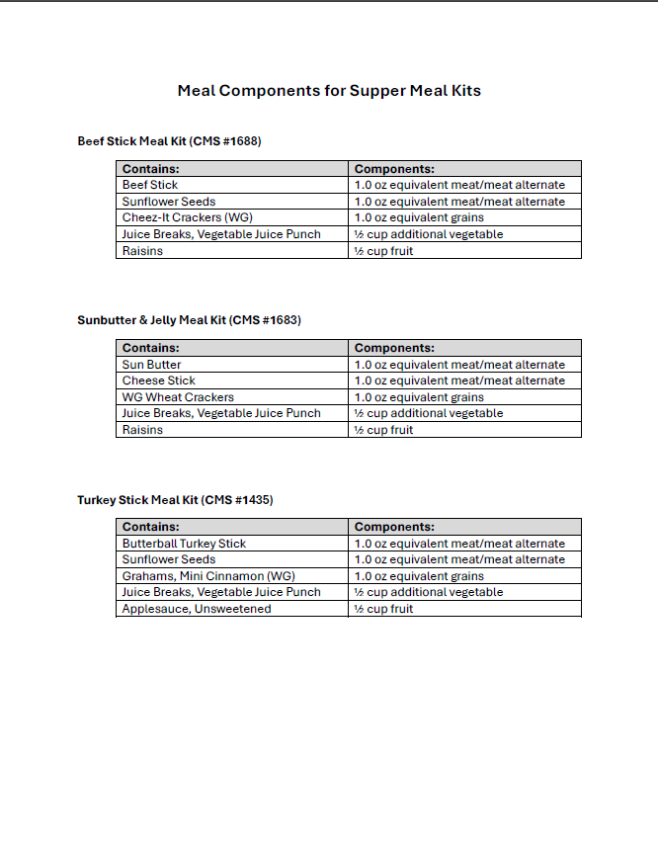
Meal Components for Supper Meal Kits
A menu has been created to detail components of all meal kits served during supper service.
Meal kit will be documented on the Daily Transport Record specifying the meal kits name and CMS number.
  Detail all components on the Daily Transport Record.
  Staple the “Meal Components for Supper Meal Kits “ menu to the Daily Transport Record.
Food services website > Menu > Menu Resources
Or

Slide 20
HOW TO SPOT A REIMBURSABLE MEAL

Slide 21
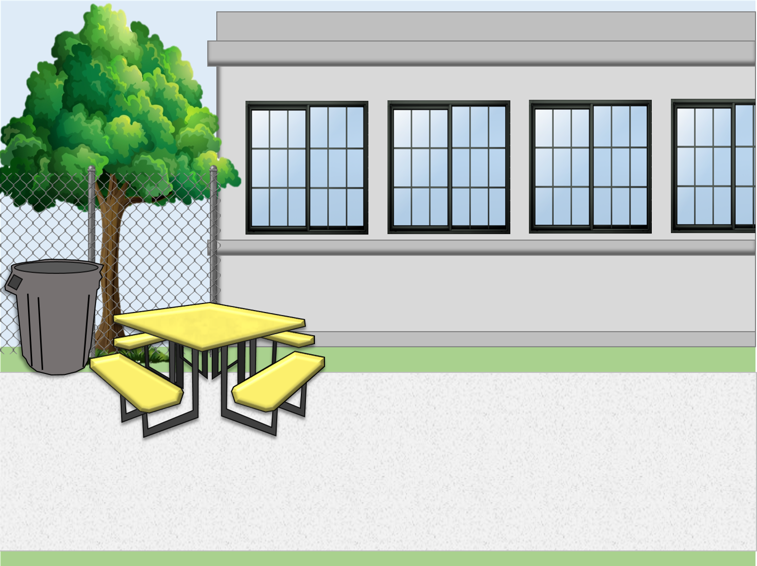
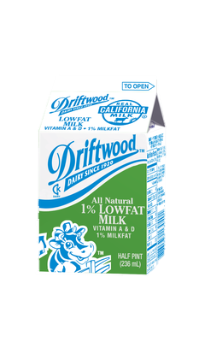
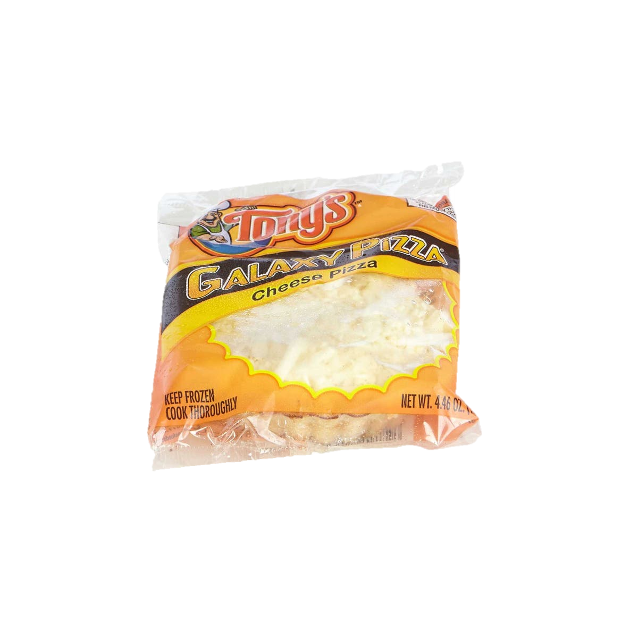









Today’s Menu Items
1 component food items
2 components entrée
Is this a reimbursable meal?

Slide 22
Today’s Menu Items
1 component food items
2 components entrée
Is this a reimbursable meal?

Slide 23
Today’s Menu Items
1 component food items
2 components entrée
Is this a reimbursable meal?

Slide 24
REMINDER
Student is not required to take a vegetable or fruit during supper
3 of the 5 meal components must be selected to complete a reimbursable meal.

Slide 25
Supper Cart Set Up
Because of the OVS model, a supper cart and the BIC dolly may need to be used together to serve supper.
Store food items in BIC insulated bags before service
Use BIC dolly to carry additional bags to supper area on campus
Use the shelf space on cart to store 3lb trays and sporkettes
Highly recommended to set up near a lunch table in the designated eating
area.

Slide 26

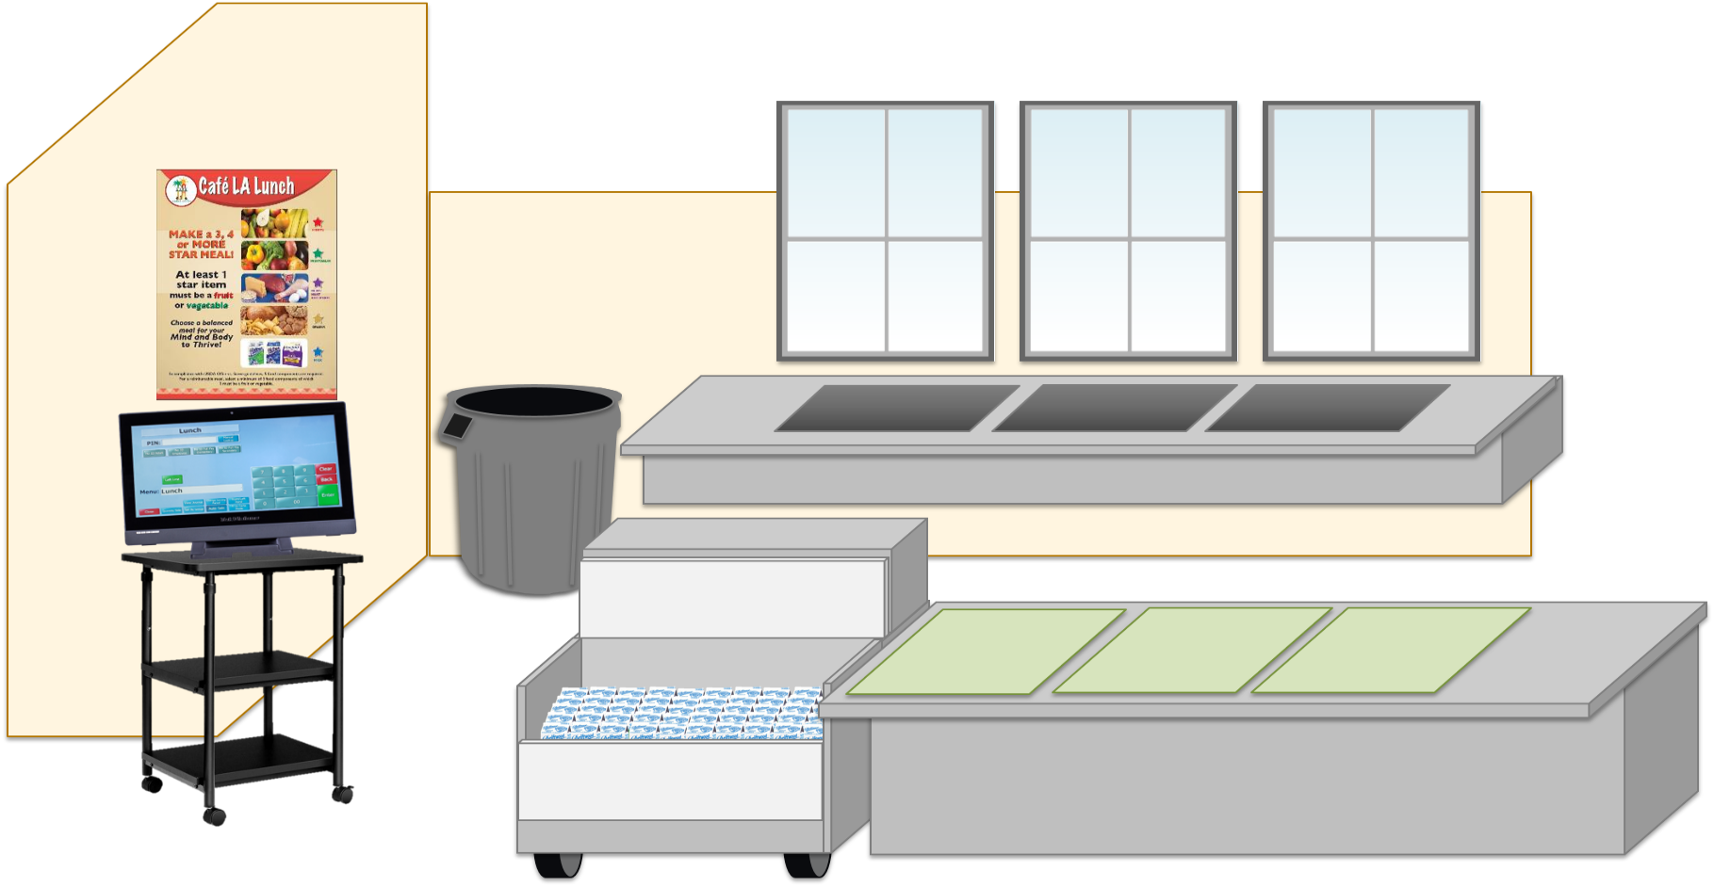

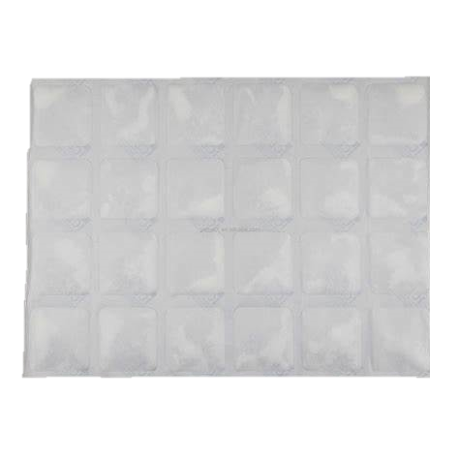


Ice Blankets
When packing supper meals for after school programs use the frozen ice blankets to ensure serving temperatures of cold food items.
Six (6) frozen ice blankets (CMS #4205) per insulated bag
Ice packs should be refrozen daily
Discard damaged (leaking, torn) ice blankets
Refer to the “Ice Blankets Best Practice” located on the Café LA website

Slide 27
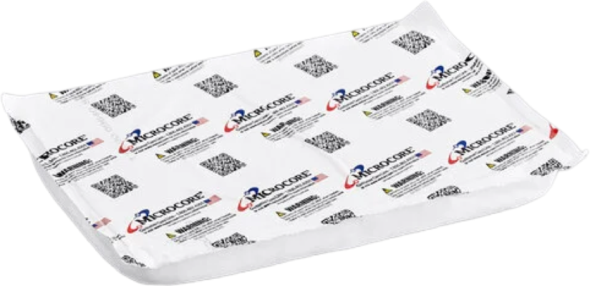
Hot Gel Packs
When packing supper meals for after school programs use the hot gel packs to ensure our serving temperatures of hot food items.
Two (2) hot packs (CMS #4770) per insulated bag
Wear cotton gloves when handling heated hot gel packs
Discard damaged hot gel packs
Refer to the “Hot Gel Packs Best Practice” located on the Café LA website for additional information

Slide 28



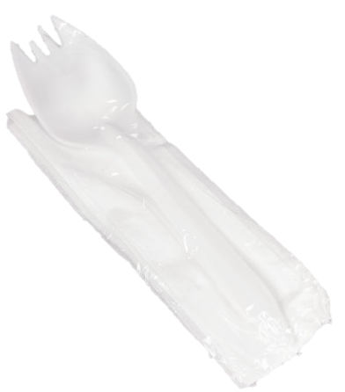
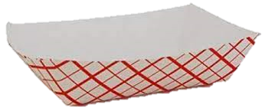

Supper Cart Set Up Example
Your set up may differ according to your participation counts, campus and weekly menu.
Store less popular items in same bag to maximize space
Do not crush or squeeze food items into bags; use an additional bag
This model allows for OVS

Slide 29
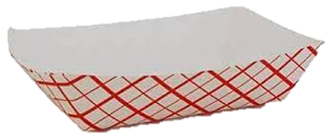
Supper Service Example
Staff must ensure reimbursable meals are served BEFORE recording the meals on the ASP/Community Forms. Meals served that are not reimbursable cannot be claimed.
Notes:
“Staff must ensure reimbursable meals are served BEFORE recording the meals on the ASP/Community Forms. Meals served that are not reimbursable cannot be claimed.”

Slide 30
Community Cart Service
Meal Service lasts for 30 mins immediately after the bell rings, however FSM’s may request approval to shorten or lengthen their meal service through their AFSS.
ASP Staff must ensure reimbursable meals are served BEFORE recording the meals on the ASP/Community Forms. Meals served that are not reimbursable cannot be claimed.
Food Services Staff serves meals to participants from the community
Meals are consumed in the designated eating area. No food may leave the campus.
Redirect program students to the program serving area to receive their meals.
ASP Staff assists with community service for the first ten minutes.
Communicate with ASP to ensure at least one point of service remains open for the entire 30-minute meal service.
    *Exceptions may apply. AFSS approval is required to serve at alternate serving times.

Slide 31
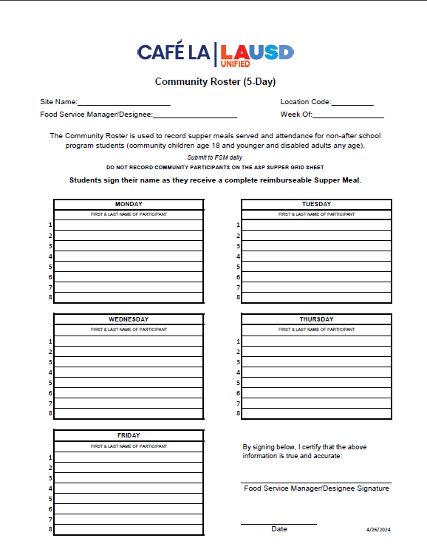
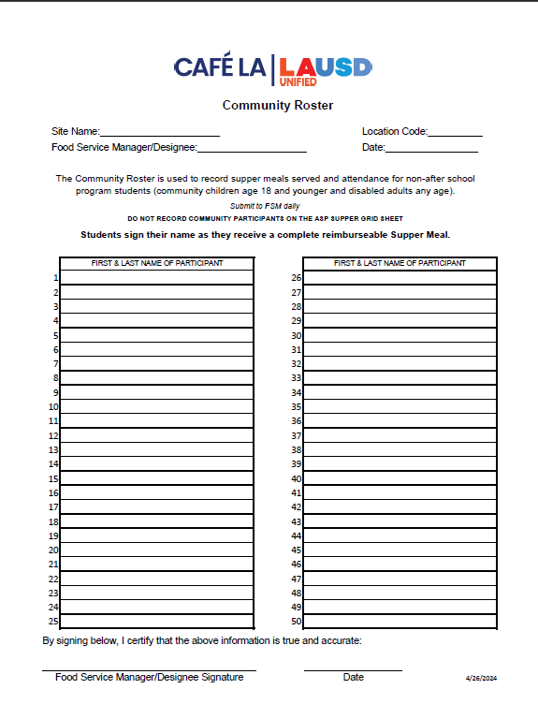
Counting and Claiming Forms
ASP Supper Grid Sheet
Community Roster
5-Day
1-Day
5-Day
1-Day
Notes:
TELL: Let’s talk about the Counting and Claiming forms. There are 2 versions of the ASP Supper Grid Sheet and the Community Roster: a 5-day and 1-day. Let’s begin with the ASP Supper Grid Sheet.

Slide 32
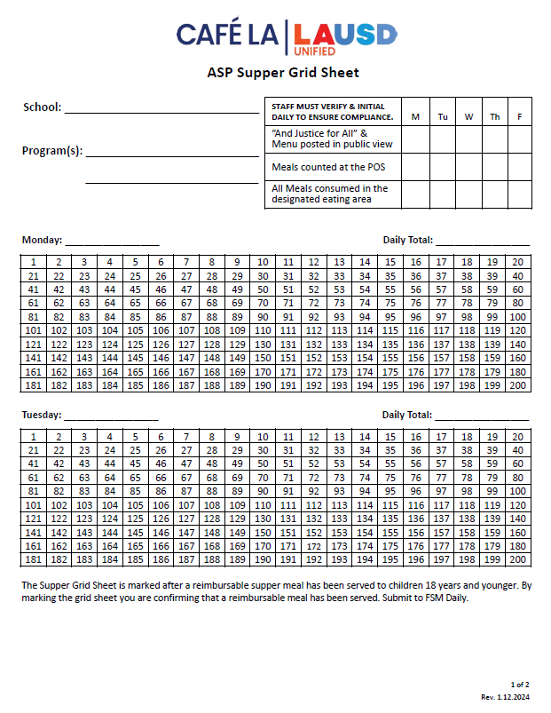
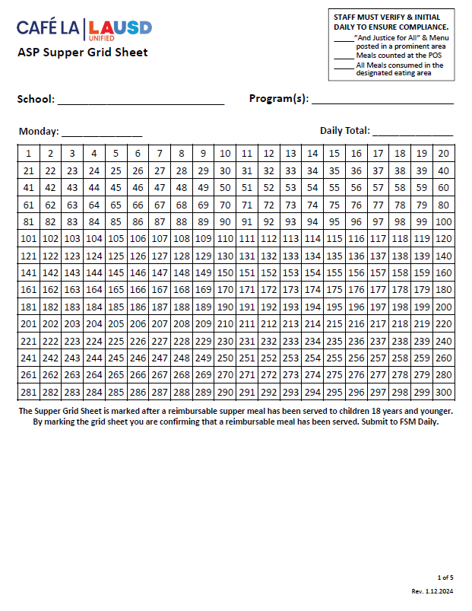
ASP Supper Grid Sheet
These forms record reimbursable meals distributed to the afterschool program students only.
Only trained staff may record meals.
Complete heading, date, and record all programs.
Verify and initial the compliance box daily.
POS staff should focus solely on counting reimbursable meals.
Mark each meal in numerical order with a slash or x AFTER a reimbursable meal is served.
Record total meal counts daily.
Submit to FS Manager daily.
5-Day
1-Day
Notes:
TELL: The ASP Supper Grid Sheet records reimbursable meals distributed to the after school program students only. Only trained FS/ASP staff may record the meals distributed. To begin, complete the heading, date, and record all programs. ASP staff must verify and initial the compliance box daily. To claim meals for reimbursement, confirm meal is reimbursable before marking. Then, mark each meal in numerical order with a slash or X. Lastly, record the total meal counts daily. Remember to collect the ASP Supper Grid Sheet daily.

Slide 33
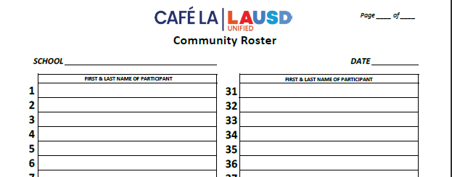
Community Roster
    This form records the attendance and reimbursable meals received by community participants.
      Ensure first & last names are written legibly.
      FS Staff ensures a reimbursable meal is selected before names are recorded
      Young children may be assisted with writing their names.
      A Roster is required at all service locations.
      To ensure accuracy in meal accounting, the POS staff should focus solely on counting reimbursable meals
      Submit to FS Manager daily.
1 2
Nicole Waterford
Hannah Bankole
Notes:
TELL: The Community Roster records the attendance and reimbursable meals received by community participants. Ensure first and last names are written legibly. Young children may be assisted with writing their names. This form is required at all service locations. Incomplete names listed may be included in the meal count. However, make every effort to obtain the full name at the next supper service. Remember to collect Community Roster daily.

Slide 34
Early Dismissal Policy
Example: Regular dismissal time is at 2:30pm.
    Meal service times are contingent upon school dismissal.
Cut-Off Time: | Before 1:00 pm | After 1:00 pm
Rule: | Students are served at the regular dismissal time | Students are served at the early dismissal time
Scenario: | Students are dismissed at 12:50pm | Students are dismissed at 1:20pm
Service Time: | Students are served at *2:30pm | Students are served at 1:20pm
    *Exceptions may apply. AFSS approval is required to serve at alternate serving times.
Notes:
TELL: Meal service times are contingent upon school dismissal. Let’s Review the Early Dismissal Policy Chart. Early release days are now categorized into 2 simple categories.
CLICK
TELL: If the students are released before 1pm, Hot supper will be served at the regular dismissal time. For example. Let’s say the regular school dismissal is at 2:30pm.
CLICK
TELL: Let’s explore this scenario. Students are released at 12:50 pm.
CLICK
TELL: According to the Early Dismissal policy, Hot Supper will be served at 2:30 pm. Please note that *Exceptions may apply. AFSS approval is required to serve at alternate serving times.
CLICK
TELL: Let’s look at a different scenario. If the students are released earlier then their regular dismissal, but after 1pm. Then Hot supper will be served Immediately after the early dismissal time.
CLICK
TELL: Let’s explore this scenario. Students are released at 1:20 pm.
CLICK
TELL: According to the Early Dismissal policy, Hot Supper will be served at 1:20 pm.

Slide 35
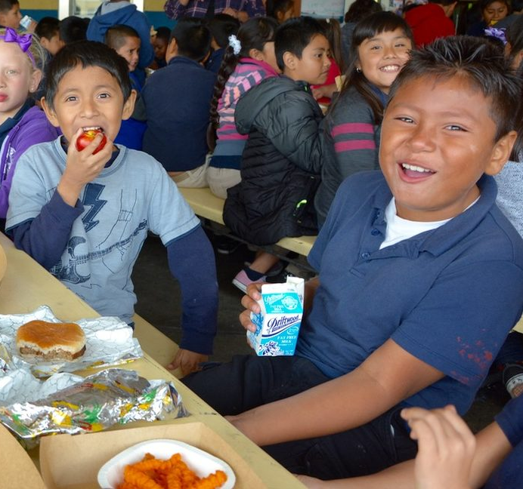
Early Release Students
Service time may be adjusted to accommodate students released before the regular dismissal bell on a regular basis.
These students may include:
  Special Education Students
  Bussed Students
  Other Eligible Programs
Note: Include any changes to service times in the Supper Meal Program Online Form with AFSS approval
Example: The school’s dismissal is at 2:30pm, but Special Ed students are released at 2:15pm. Serving time is 2:15-3:00pm.
Notes:
TELL: Service time may be adjusted to accommodate students released before the regular dismissal bell on a regular basis.
These students include, Special Education students and bussed students, and other eligible programs. Note: Any change in the service time must be included in the Change of Supper Meal Service Form. For example: The school’s dismissal is at 2:30pm, but Special Ed students are released at 2:15pm. Serving time is 2:15-3:00pm.

Slide 36
Food Services
Staff Role
Pre-Service
Prepare & pack supper meals according to the menu for all service areas
Notes:
TELL: Before supper service begins, Food Services staff will prepare & pack the hot supper meals according to the menu for all service areas.

Slide 37
Delivers supper meals to ASP staff to distribute to ASP participants
Distribute supper meals to community participants.
Food Services
Staff Role
Ensure reimbursable meals are marked on the community roster.
During Service
Direct all participants to the designated eating area.
Ensure no food leaves the campus.

Slide 38
Count & record all leftovers.
Check the temperatures of leftovers. Cold items may be returned to stock. Discard all hot items.
Food Services
Staff Role
Post Service
Clean & sanitize insulated bags & carts.

Slide 39
Distribute meals to program students and assist community for the first 10 minutes or as needed
Supervise & direct students to the designated eating area.
ASP Staff
Make sure program is open to the community.
Clean spills, wipe tables, pick up trash & empty bins.
Responsibilities
Total daily attendance for all programs and record accurate meal counts.
Ensure no food is taken from campus.

Slide 40
ASP Staff
WILL NOT
Prepare any food items
Push community carts out to designated areas
Remove hot food from warmers or ovens

Slide 41
Handling
Challenges
Student attempts to walk out of campus with the supper meal.
Redirect students to eat in the designated eating area.
Parent is rude or is upset after being reminded of rules.
Inform administration of the incident and request assistance.
Despite your efforts, supper regulations are not being followed.
Inform AFSS that
your repeated efforts are unsuccessful.
Notes:
TELL: Here is a guide on handling challenges. Student attempts to walk out of campus with the supper meal.
CLICK
TELL: Redirect students to eat their meal in the designated eating area. Parent is rude or is upset after being reminded of rules.
CLICK
TELL: Inform administration of the incident and request assistance. Despite your efforts, supper regulations are not being followed.
CLICK
TELL: Inform AFSS that your repeated efforts are unsuccessful.

Slide 42
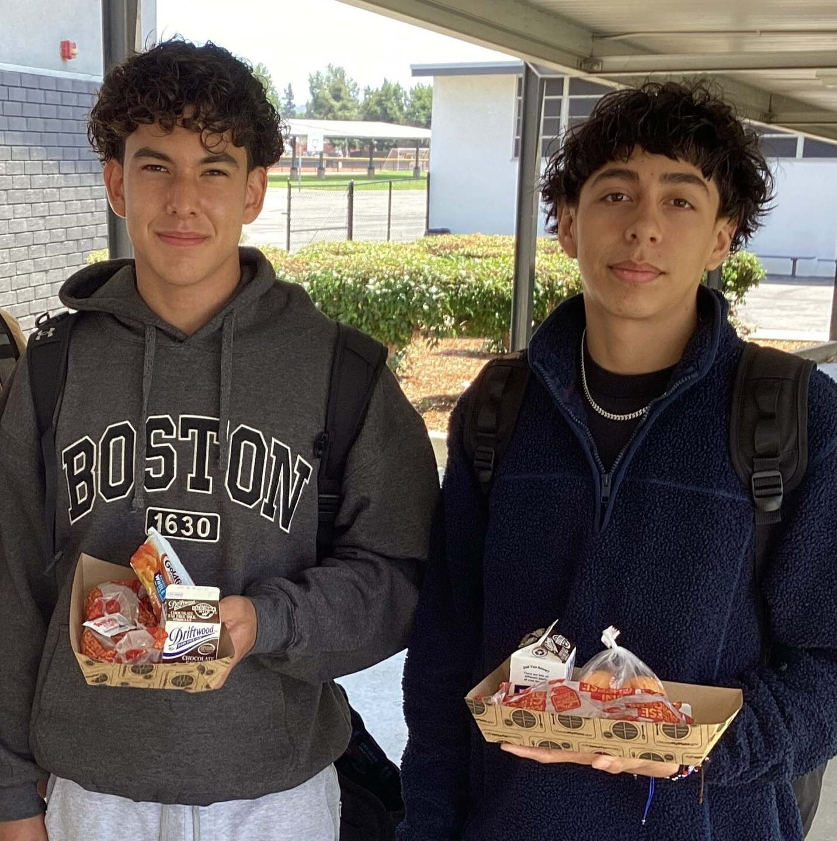
Good Nutrition
All Day Long
    Providing healthy meals shouldn’t stop once the last bell rings. Often times, parents are still at work when their children get out of school.
    Serving hot supper meals allows children to receive three nutritious meals a day to support their growing bodies and learning needs.
Notes:
TELL: Providing healthy meals shouldn’t stop once the last bell rings. Often times, parents are still at work when their children get out of school. Serving hot supper meals allows the children to receive three nutritious meals a day to support their growing bodies and learning needs. Doing this will ensure that together, we are continuing to provide good nutrition all day long.

